Slide 1
Project Presentation Multithreaded Http Server

Slide 2
Thread Pool
Thread pool consists o f a number of threads .
It is created by threadpool_create function in
Thread_pool.cpp at the starting of the server .
All client servicing threads initialized in threadpool sleeps (in the queue of conditional variable ) untill not invoked by scheduling thread.
Key functions in thread_pool activate :
pthread_create(&thread_scheduler , NULL , &Parse::popRequest_helper, P).
for (int i = 0 ; i < threadnum ; i++)
pthread_create(&threads[i] , NULL , &Parse::serveRequest_helper, P).

Slide 3
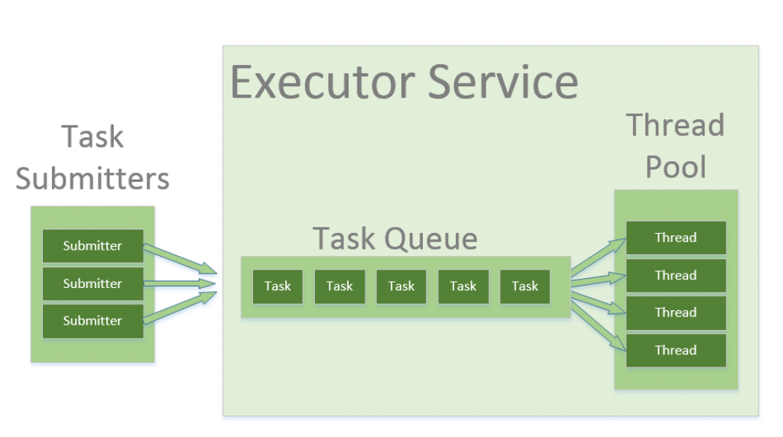
Architecture of the ThreadPool

Slide 4
Implementation detail
Main Process
This process uses threpool to create threadpool and dispatch a thread from threadpool whenever a new connection arrives.
Main Files : main.cpp , MyServer.cpp .
>> Flow in main.cpp
1. main function()
1.a dispatch_to_here(this function sets ports and others parameters)

Slide 5
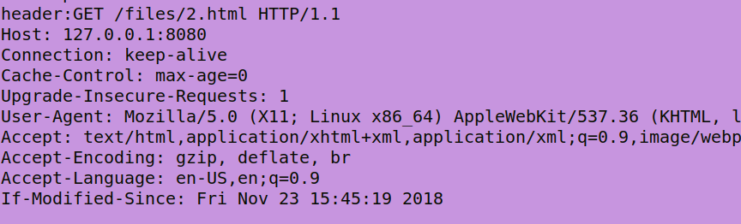
Flow in MyServer.cpp
1. getConnection
1(a). getaddrinfo -> socket create -> bind -> listen
1(b). While new request comes do following :
accept conection
set connection details in a clientIdentity object
create threadpool
dispatch a thread to dispatch_to_here function
on new client request
2. dispatch_to_here function creates a parse object and calls parserequest function.
. Flow in parse.cpp
1. parse Request
1(a). Receive http request header

Slide 6
1(b) Parse following field from header :
request_method , route address , request_type
add these fields in clientInfo object
construct absolute address of requested file
call to checkRequest function
Check Request function
2(a). If request_type is GET
Determine file status and file size
2(b). If request_type is HEAD
Determine file status , set file size = 0
2(c) else set file status = false , file size = 0
2(d) If filestatus is directory request then set
file status = false ; file size = 0
dir_status = true
call send_data function

Slide 7
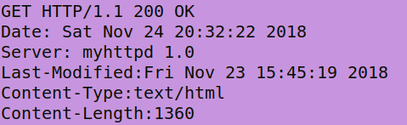
CLIENT SERVING THREADS
Main files : parse.cpp , senddata.cpp
1. SendData function is called in each thread to serve response to the client.
2. Send_data function in senddata.cpp :
create a response header using clientInfo object
sends response header first
sends file data later

